Slide 1

FOREST FIRE PREDICTION
MACHINE LEARNING CS5710

Slide 2
GROUP MEMBER INFORMATION
Sai Pavana Niharika Kali – 700740603
Nithisha Majety – 700740978
Pallavi HarishChandra Meher – 700727681

Slide 3
ROLE/ RESPONSIBILITY AND CONTRIBUTION
Sai Pavana Niharika Kali(700740603):
Worked on Dataset and SVM Algorithm
Worked on Random Forest Regression
Nithisha Majety(700740978):
Worked on Data Pre-Processing and SVM Algorithm
Worked on Linear Regression
Pallavi HarishChandra Meher(700727681):
Worked on Dataset
Worked on SMOTE technique and preprocessing data in Linear and Random Forest Regression

Slide 4
MOTIVATION
To predict or detect the occurrence of forest fire using the support vector machine, Random Forest and Linear Regression by visualizing the data in Python.
The importance of the forest fire prediction is, by calculating the probability of fire using the meteorological conditions will help us to find whenever there are chances of fire accident it will notify us by the visual representation so that we can alert at that time and prevent the occurrence of fire in forest.

Slide 5
OBJECTIVES
The objective of this study is to simulate the likelihood that a fire would occur in relation to the day, the month, specific meteorological variables here for the dataset The question we are attempting to answer is how confident we are that a forest fire will occur, not whether it will occur or not.

Slide 6
RELATED WORK
The proposed system procedures employed weather variables like temperature, rain, wind, and humidity to forecast the likelihood of a forest fire
Using RandomizedSearchCV algorithm, Random Forest Regression and Hyper - parameter Tuning was performed using a variety of sub-samples of the dataset
And then Performed Decision Tree, Random Forest and SVM(Support Vector Machine), and Artificial Neural Networks (ANN) algorithms.
Hyperparameter tuning yields the best outcomes of Root mean square error (RMSR) is equal to 0.07, Mean absolute error (MAE) is 0.03 and Mean square error (MSE) is 0.004.

Slide 7
PROBLEM STATEMENT
Forest fires are one of the major natural disasters, which is creating economic and ecological damage and endangering human lives.
If the forest fire is detected in early stage and quick action is taken, then the damage caused by forest fire can be minimized
It not only damages the forest wealth but also effects the human lives. It causes ecological imbalance
Here we use the SVM, Random Forest Regression and Linear Regression are used to predict the forest fires based on the current parameters and pre defined values

Slide 8
PROPOSED SOLUTION
In this project, We perform SVM classification and find out the accuracy of fire prediction
Later we apply SMOTE technique to remove imbalancy in data and find out the accuracy after applying the SMOTE technique
Then Linear Regression is used to find out the R2 Score and Adjusted R2 Score
Random Forest Classifier is then performed and R2 Score and Mean Absolute Error is calculated
Thus we compare the accuracies of all the algorithms performed and predict the fire occurence

Slide 9
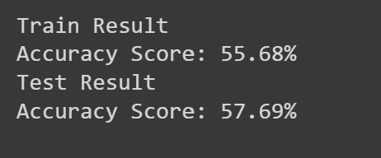
RESULTS
SVM : The below image is the result for Accuracy percentages which is obtained by performing SVM to the training and testing data set

Slide 10
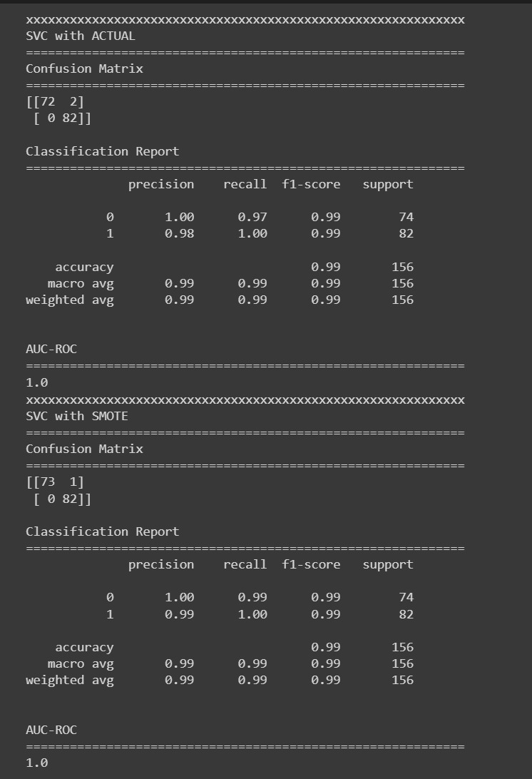
RESULTS
SVM_SMOTE: The below image is the result for Accuracy percentages which is obtained by performing SMOTE techniques to the SVM which is used to overcome the fitting problem

Slide 11

RESULTS
LINEAR REGRESSION: We have two different accuracies in Linear regression which is R2 and Adjusted R2.Accuracy of model increases whenever we increase the features. But the adjusted R2 will remain unaffected inspite of features

Slide 12
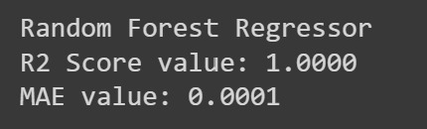
RESULTS
RANDOM FOREST REGRESSION: The below image is the result for accuracy which is obtained by performing Random forest regression algorithm to the data set.

Slide 13
REFERENCES
[1] P. Rakshit et al., "Prediction of Forest Fire Using Machine Learning Algorithms: The Search for the Better Algorithm," 2021 6th International Conference on Innovative Technology in Intelligent System and Industrial Applications (CITISIA), 2021, pp. 1-6, doi: 10.1109/CITISIA53721.2021.9719887..
[2] T. Preeti, S. Kanakaraddi, A. Beelagi, S. Malagi and A. Sudi, "Forest Fire Prediction Using Machine Learning Techniques," 2021 International Conference on Intelligent Technologies (CONIT), 2021, pp. 1-6, doi: 10.1109/CONIT51480.2021.9498448.
[3] S. Natekar, S. Patil, A. Nair and S. Roychowdhury, "Forest Fire Prediction using LSTM," 2021 2nd International Conference for Emerging Technology (INCET), 2021, pp. 1-5, doi: 10.1109/INCET51464.2021.9456113.

